Slide 1
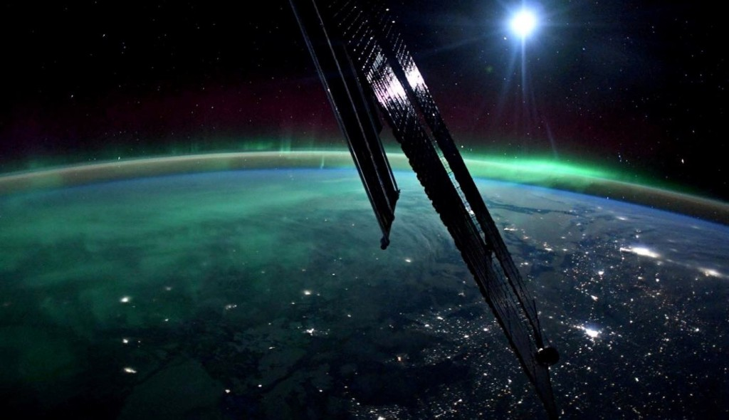
Magnetic Reconnection - solved with astrophysics and data science
Presented by Space Bricks
(These slides are best viewed in slideshow mode)
Background image: Josh Cassada / SWNS

Slide 2

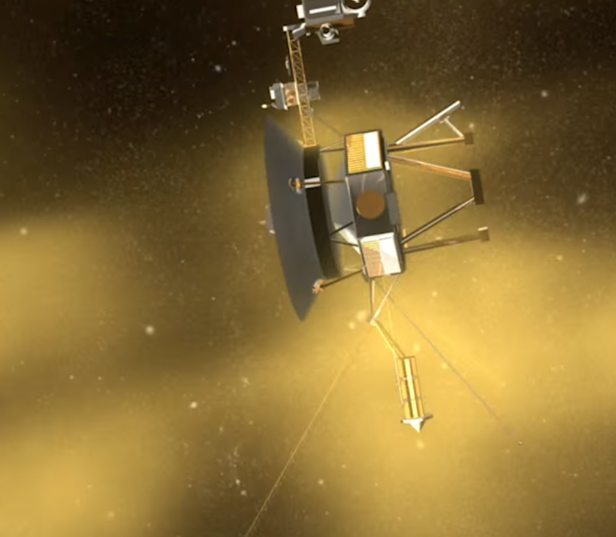

What is Magnetic Reconnection (MR)?
Interplanetary magnetic field (IMF) line breaks and connects again.
Huge energy! Particles now invade earth’s magnetosphere!!
$→$ Aurora light, Satellite damage!
NASA's Conceptual Image Laboratory

Slide 3
Space Bricks proudly presents: PAMRI
Astrophysics concepts + automatic data science analysis =
Physics Automatic Magnetic Reconnection Identifier (PAMRI) (python)
Astrophysics:
Data science:
Collect papers for reference
Set parameters and thresholds
Set MR conditions
Interpret results with real world numbers
NASA open data (ACE)
Noise filter
Peak detection
Probability density
Result: MR expected occurrences
MR or noise?

Slide 4
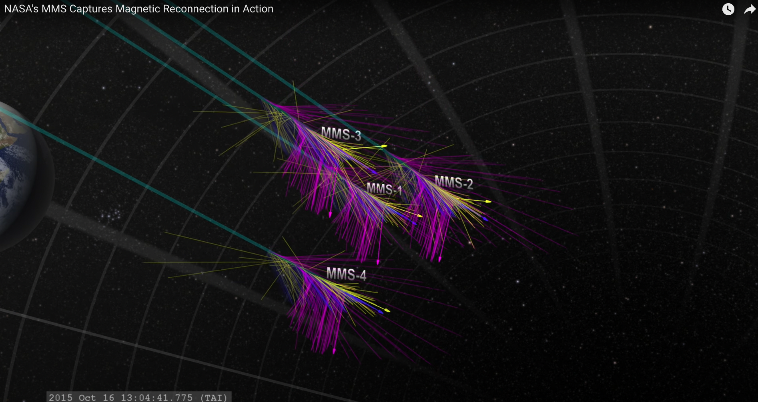
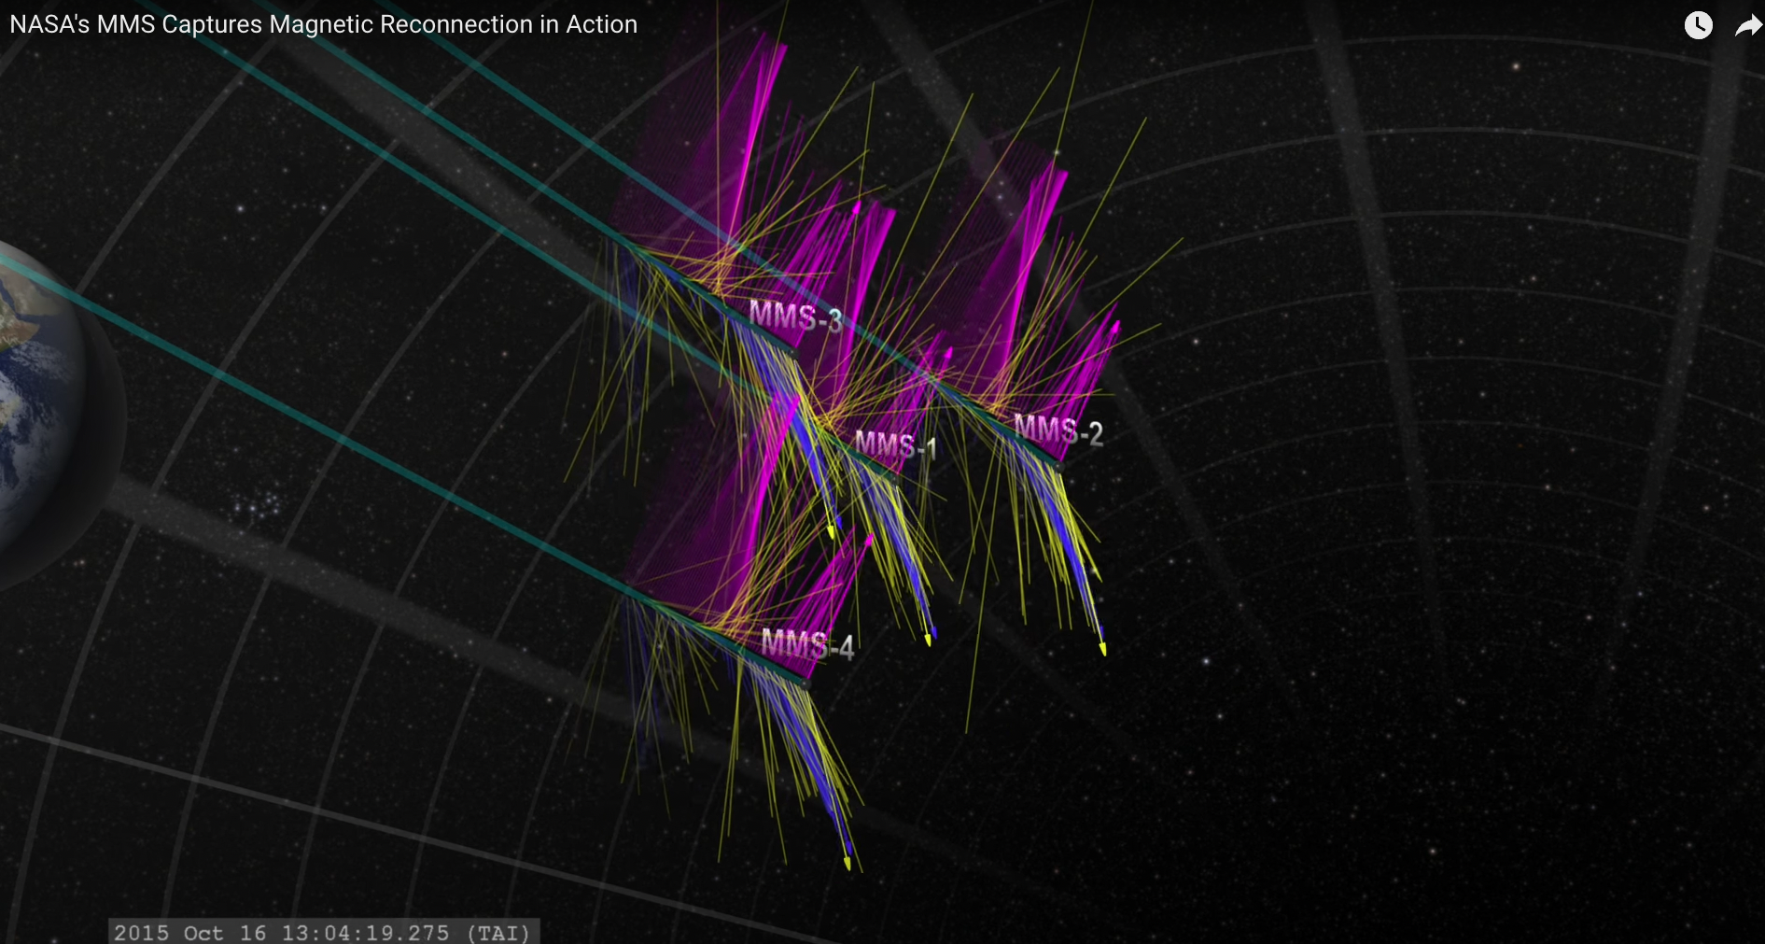
Identify MR event
physical conditions:
Rapid change (peak) in magnetic field amplitude.
Z-direction switches sign between peaks.
@NASAGoddard youtube channel

Slide 5

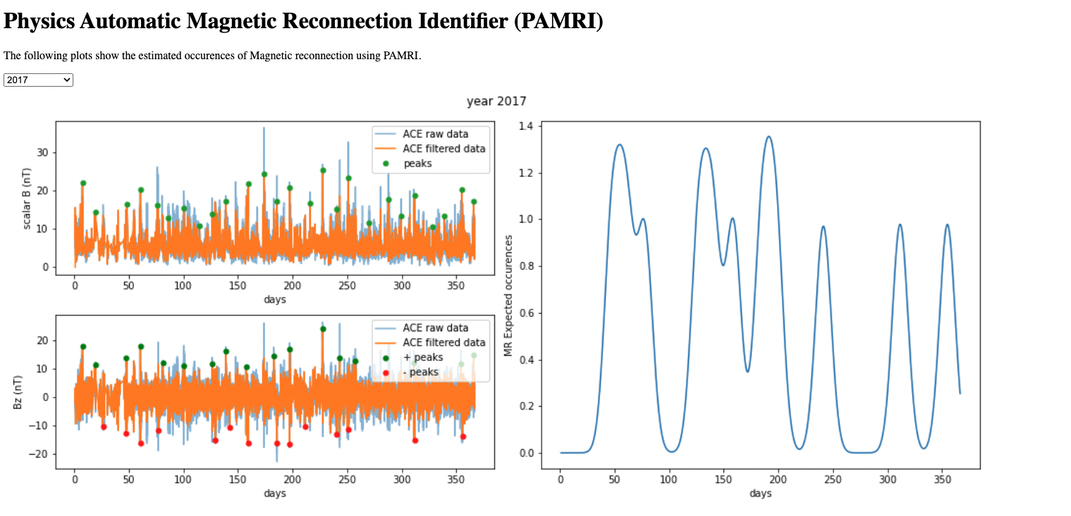
Quick Demo:
Download on github: https://github.com/Johnny880724/PAMRI
Condition 1+2
Identify as MR
No condition 2 not MR

Slide 6
This is not possible without:
Package used: numpy, scipy, matlab
Paper References:
Deng, Matsumoto (2001), Nature
Wei, F., Hu, Q., Feng, X., Fan, Q. (2003). Advances in Space Environment Research
NASA resources used:
ACE magnetic field data
Video: Magnetic Reconnection
Video: NASA's MMS Captures Magnetic Reconnection in Action
Project by Space Bricks:
Bing-Jyun Tsao
Graduate student
UT Austin, Physics
Kuan-Ju Chou
Graduate student
NYCU, Communications Engineering

